Slide 1
Introduction
A gym chain would like to open up a new gym in Toronto
The question for the remainder of this exercise is: Where should I open up my gym best?

Slide 2
Considerations
Next to price, proximity of a gym to user is key determinant of which gym a prospective gym user will sign up to
The average user is willing to commute up to 1.5km to get to a gym
Therefore, the key determinant where to open up a gym is: Are there any other gyms within a 1.5km radius from mine?

Slide 3
Data used
Wikipedia export using Beautifulsoup
Foursquare export

Slide 4
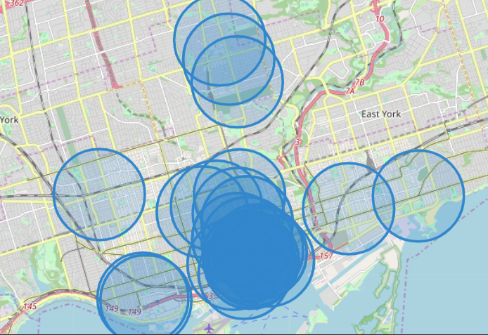
Results
Lots of gyms are in the center of the city
There are, however, still some spots available outside of the reach of existing gyms (highlighted in red)
= white spots
= radius of existing gym

Slide 5
Conclusion
Consider opening up a gym in the area of East York to avoid any competition

Slide 6
Next steps
Explore the area of East York more in detail before deciding where to exactly open up your gym

